Slide 1
Newton’s Universal Law of Gravitation
Chapter 8

Slide 2
Gravity
What force causes an apple to fall towards the surface of the Earth?
What force causes the moon to orbit the Earth?
What force causes the Earth to revolve around the Sun?
Sir Isaac Newton developed his Universal Law of Gravitation around 1666 after seeing an apple fall from a tree.

Slide 3


Universal Gravitation
What is it?
  The force of attraction between any two masses in the universe.
  It depends upon:
    The square of the radial distance between the two bodies (center to center).
    The product of the masses of the two bodies.
    Universal Gravitational Constant (6.67 x 10⁻¹¹ Nm²/kg²)
m₁
F =
G
m₁m₂
r²
m₂
r

Slide 4
Gravitational Fields
Objects with MASS produce gravitational fields
Field lines point inward from ALL DIRECTIONS

Slide 5
m and r vs. Force (The Inverse Square Relationship)
What affect does changing the mass have on gravitational force?
  If you double the mass on one body, you will double the gravitational force.
What affect does changing the distance have on gravitational force?
  If the distance between two objects is doubled, the gravitational force will decrease by 4 x.
  If the distance between two objects is halved, the gravitational force will increase by 4 x.
    The inverse square relationship – F ∝ 1/r²

Slide 6
The Inverse Square Relationship
ISS orbit
(400 km)
g = 8.65 m/s²
r_{E} = 6380 km
Geosynchronous Orbit
(36,000 km)
g = 0.23 m/s²

Slide 7
Example 1:
How will the gravitational force on a satellite change when launched from the surface of the Earth into an orbit
  1 Earth radius above the surface of the Earth?
  2 Earth radii above the surface of the Earth?
  3 Earth radii above the surface of the Earth?
F_{1r} = ¼ F
F_{2r} = 1/9 F
F_{3r} = 1/16 F
r
r
r
r
Why?
F ∝ 1/r²
Don’t forget the Earth’s radius!

Slide 8
Determining the mass of the Earth
Newton’s 2nd Law of Motion:
F_{g} = mg
Newton’s Universal Law of Gravitation:
F_{g} = Gm_{E}m
r²
By setting the equations in 1 and 2 equal to each other, the mass will drop out.
mg = Gm_{E}m
r²
Rearranging to solve for m_{E}:
m_{E} = gr²/G

Slide 9
Determining the mass of the Earth
Substituting in know values for G, g and r
  G = 6.67 x 10⁻¹¹ Nm²/kg²
  g = 9.81 m/s²
  r = 6.38 x 10⁶ m
  m_{E} = (9.81 m/s²)(6.38 x 10⁶ m)²
  (6.67 x 10⁻¹¹ Nm²/kg²)
  m_{E} = 5.98 x 10²⁴ kg

Slide 10


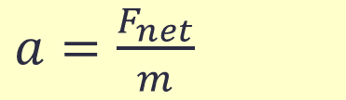



Why do all objects in free-fall, fall at the same rate?
$a=\frac{F_{net}}{m}$
$$=g$$
The net force acting on objects in free fall near the surface of the Earth is equivalent to its weight, which means that they fall at 9.81 m/s².
If we now substitute the equation for the Universal Law of Gravitation...
Simplifying we see that the mass is cancelled out. Hence mass does not matter.
$$g=\frac{F_{g}}{m}$$
$$g=\frac{G\frac{m{∙m}_{E}}{r_{E}^{2}}}{m}$$
$$g=G\frac{m_{E}}{r_{E}^{2}}$$

Slide 11
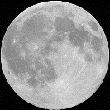
Example 2:
The Earth and moon are attracted to one another by a gravitational force. Which one attracts with a greater force? Why?
  Neither. They both exert a force on each other that is equal and opposite in accordance with Newton’s 3rd Law of Motion.
F_{moon on Earth}
F_{Earth on moon}

Slide 12
Kepler’s Laws of Planetary Motion
Law #1:
  The paths of planets are ellipses with the sun at one of the foci.

Slide 13
Kepler’s Laws of Planetary Motion
Law #2:
  The areas enclosed by the path a planet sweeps out are equal for equal time intervals.
  Therefore, when a planet is closer to the sun in its orbit (perihelion), it will move more quickly than when further away (aphelion).

Slide 14
Kepler’s Laws of Planetary Motion
Law #3:
  The square of the ratio of the periods of any two planets revolving around the sun is equal to the cube of the ratio of their average distances from the sun.
T_{A} r_{A}
T_{B} r_{B}
    When dealing with our own solar system, we relate everything to the Earth’s period of revolution in years (T_{E} = 1yr) and distance from the Sun (r = 1 AU) such that T² = r³.
  The farther a planet is from the sun, the greater will be the period of its orbit around the sun.
2
3
=

Slide 15
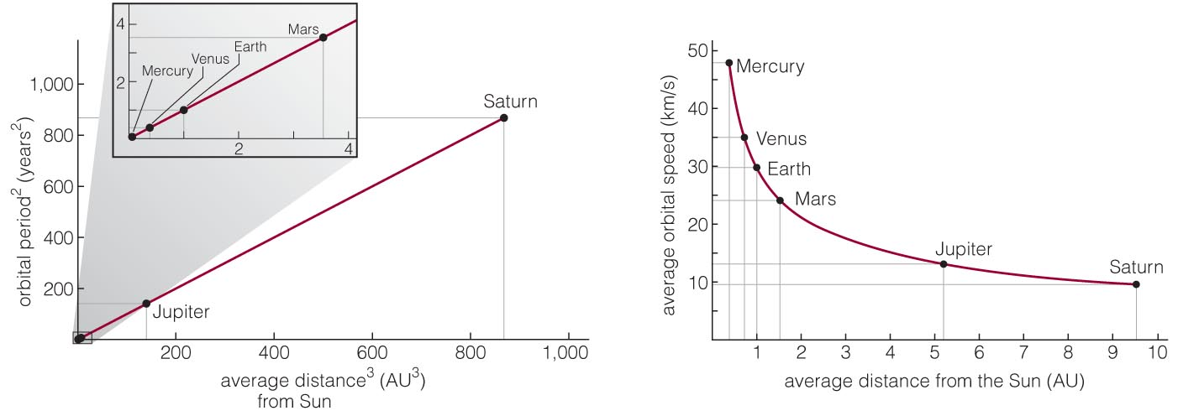
Graphical version of Kepler’s Third Law
Notes:
Use these graphs to show the meaning of the equation for Kepler’s third law. Note: if your students are not too afraid of the math, show them why a planet’s average speed is 2πa/p (circumference of orbit divided by orbital period), then substitute from Kepler’s third law to show that speed is proportional to 1/√a so that they can understand the shape of the curve in (b).

Slide 16
An asteroid orbits the Sun at an average distance r = 4 AU. How long does it take to orbit the Sun?
4 years
8 years
16 years
64 years
We need to find p so that T² = r³
Since r = 4, r³ = 4³ = 64
Therefore T = 8, T² = 8² = 64

Slide 17
Key Ideas
Gravity is a force of attraction between any two masses.
Gravitational force is proportional to the masses of the bodies and inversely proportional to the square of the distances.
Acceleration due to gravity decreases with distance from the surface of the Earth.
All planets travel in ellipses.
Planets sweep out equal areas in their orbit over equal periods of time.
The square of the ratio of the periods orbiting the sun is proportional to the cube of their distance from the sun.

Slide 18
Universal Gravitation
In 1666, Isaac Newton developed a basic mathematical relationship:
F ∝ 1/r²
  This relationship was used to describe the attractive force between the Sun and the planets where r is a line drawn through the center of the two bodies.
r

Slide 19
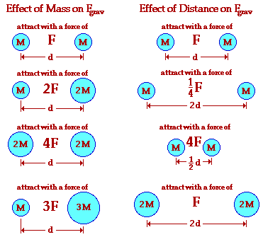
The Effects of Mass and Distance on F_{g}

